Slide 1

Credit Score Classification
Group 7:
Abiodun Bello
Ying-Tzu Chen
Mrudula Jethe Bhanushali
Shruthi Ramesh
Arwin Kumar Ravi
Rohith Thiagarajan

Slide 2

Motivation
In today's financial landscape, access to credit is an essential factor in enabling individuals and businesses to grow, while managing risk for financial institutions. Credit scores play a pivotal role in determining an individual’s or entity’s eligibility for loans, mortgages, and credit cards. However, traditional methods of credit score assessment—relying on manually-defined criteria and rules—can be limited, prone to biases, and less effective at capturing the complex relationships between different financial behaviours and creditworthiness.
In this project implementation we offer a promising solution to this challenge which will improve the following factors:
Enhanced Risk Assessment
Personalized Credit Scoring
Reducing Bias
Improved Financial Inclusion
Cost Efficiency and Automation
Scalability

Slide 3
Overview Of the Dataset
This particular dataset was acquired from Kaggle. The dataset has 100,000 records providing the customer data relating to various financial prospects.
No. of Attributes = 28
Credit_Score: Whether customer has a Good, Standard or Poor credit score. (Target Variable)
Other Dependent Variables: Month, Age, Occupation, Annual_Income, Monthly_Inhand_Salary, Num_Bank_Accounts, Num_Credit_Card, Interest_Rate, Num_of_Loan, Delay_from_Due_Date, Num_of_Delayed_Payment, etc.
Number of Categorical Features =12; Number of Numerical Features = 16

Slide 4
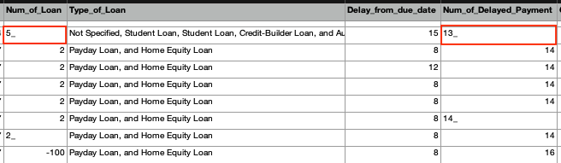
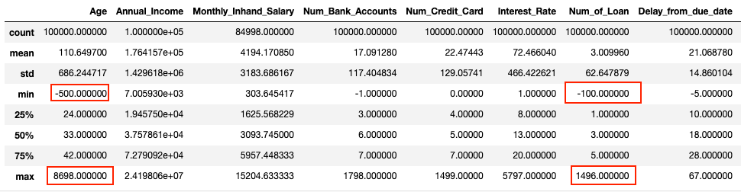
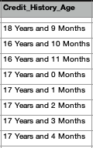
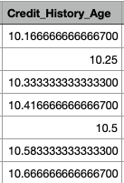
Data Cleaning
Step I: Checking for Duplicate Rows. Fortunately, our data had no duplicate rows.
Step II: Cleaning numerical columns containing entries with some characters as anomalies.
Step III: Dropping columns that will not be required. Here we drop the columns 'SSN' and 'Name'.
Step IV: Handling null values and anomalies in numerical columns. For instance, most numerical columns had outliers and negative values as well. We replaced these values and Null with the value occurring before or after that specific record when the data was grouped by 'Customer_Id'. A range of values was enforced for the numerical variables to avoid extremely high or negative values using the Inter Quartile Range formula.
Step V: Typecasted the 'Credit_History_Age' column to a float by converting the original string with number of years and months to total number of years (float).
Step VI: Handling anomalies in categorical variables. Some variables had some random values which were replaced by a similar value when grouped by the 'Customer_Id'.

Slide 5
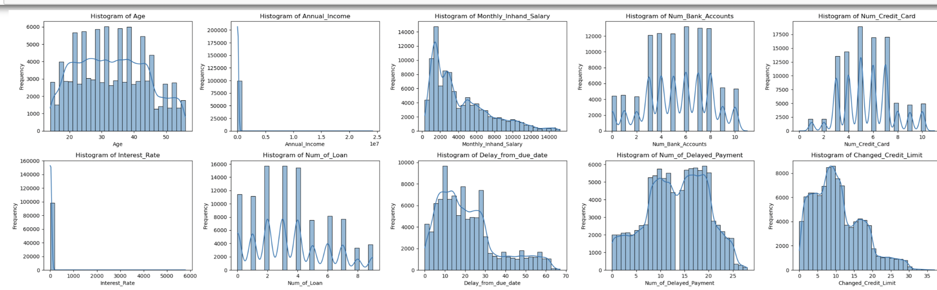
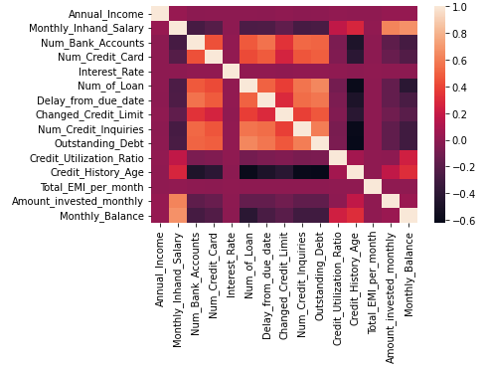
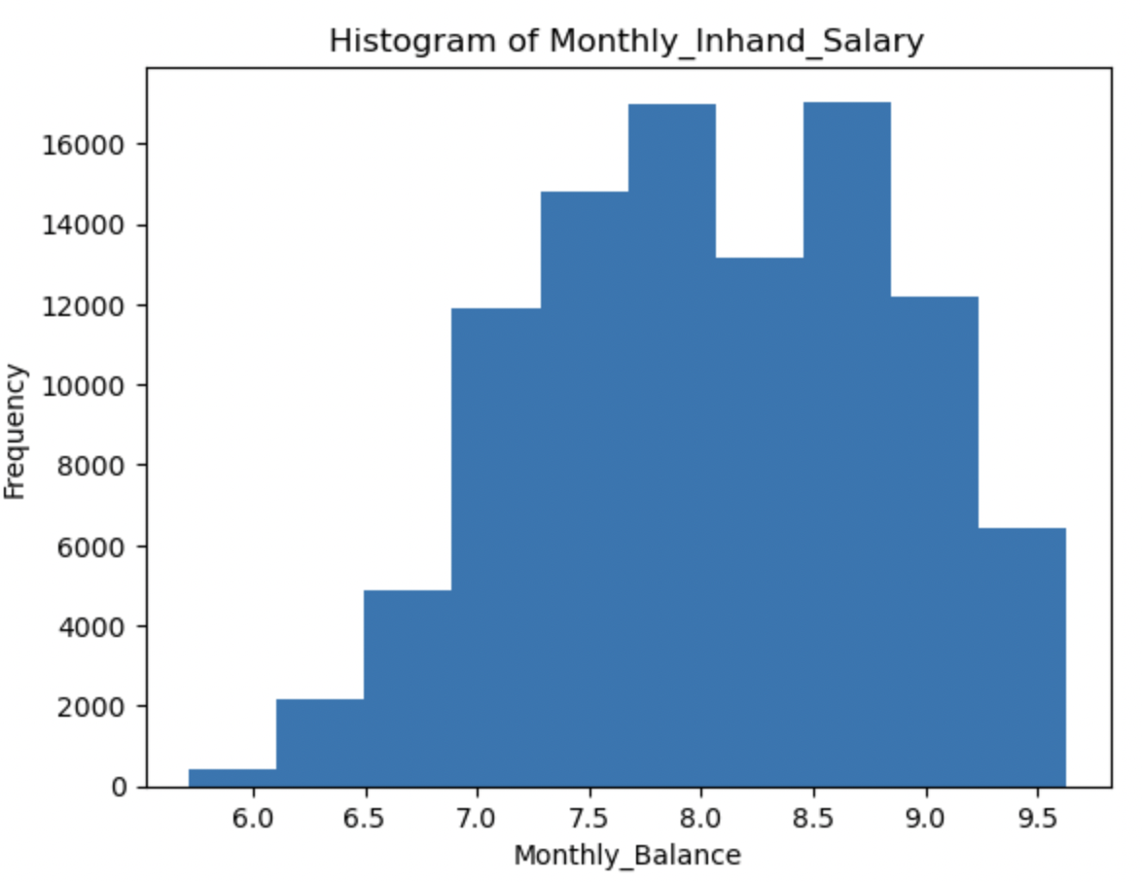
EDA
A correlation matrix is used to visualize the relationships between the numerical variables.

Slide 6
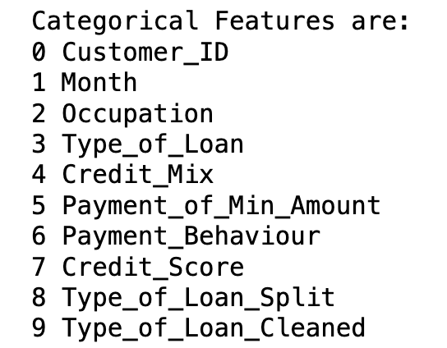
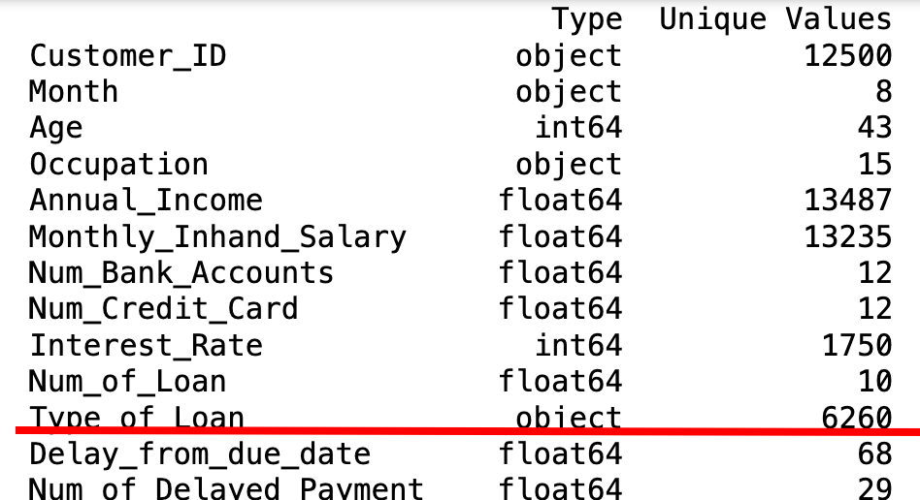
Data Preprocessing - One-Hot Encoding
8 categorical features (exclude the customerID and credit score )
Type of loan is particularly tricky because it has 6,000 unique values
Notes:
Among 25 features, we have 8 categorical features (exclude the customerID and credit scrore ).
To train the SVM, KNN, log-reg models, we have to convert them into numbers using one-hot encoding.
And in these 8 features, type of loan is particularly tricky because is has 6,000 unique values
If we use one-hot coding directly, we would have more than 6,000 columns.
SO, we had to look into the type of loan
---one-hot
I applied one-hot encoding to the cate columns to convert its categorical values into numerical format. Each unique category in the column was represented as a new binary feature (0 or 1).

Slide 7
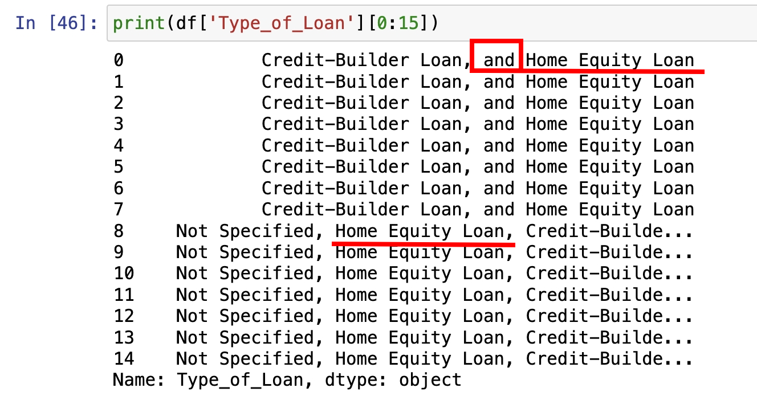
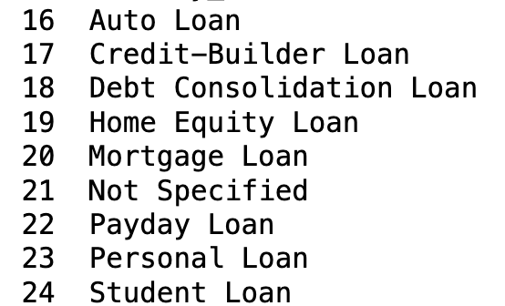
Data Preprocessing: Type of Loan
Each data is a list, has several types inside
Redundant 'and'
Result
9 unique types
Value 0, 1
Notes:
We can see each value is a list, it's combined with several types of loans.
So, first we should separate those types indside.
The 2nd problem is it used different text for the same type.
You can see it sometimes add a 'and' in front of the loan's name
We have to make sure the one-hot coding result count them as the same type.
After addressing the problem, it turns out that there are 9 types of loan here.
Then, we converted all other categorical features, our columns grow from 25 to 60

Slide 8
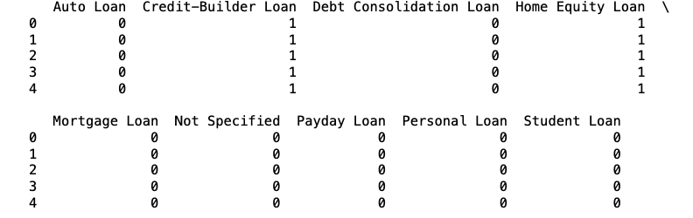
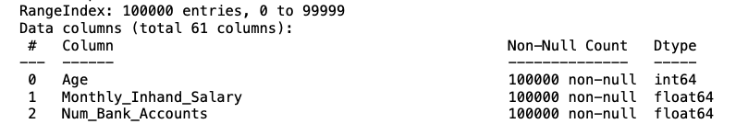
Data Preprocessing: Type of Loan & Other Categorical Features
Type of Loan turned into 9 new columns
After converting all categorical features …
Features: 30 to 61

Slide 9
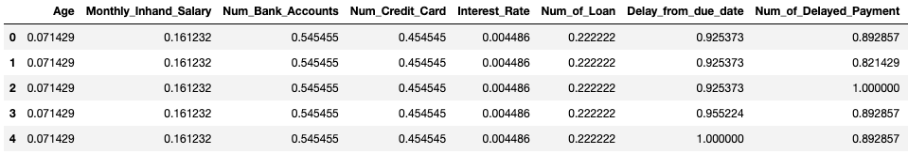
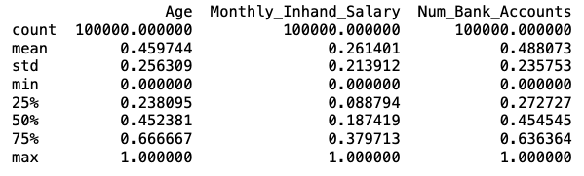
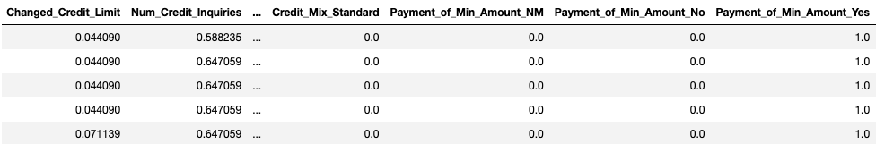
Data Preprocessing - Scaling
After one-hot encoding and the creation of dummy variables for categorical variables, the data needs to be scaled to avoid bias. We use the MinMaxScaler from the sklearn preprocessing module achieve the same.

Slide 10
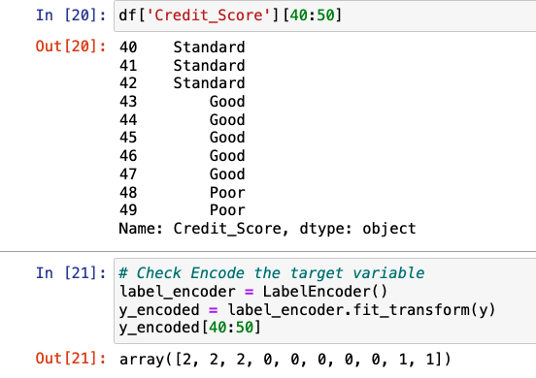
Data Preprocessing – Encoding Y
Credit Score: Standard, Good, Poor
Covert into: Standard: 2, Good: 0, Poor: 1

Slide 11
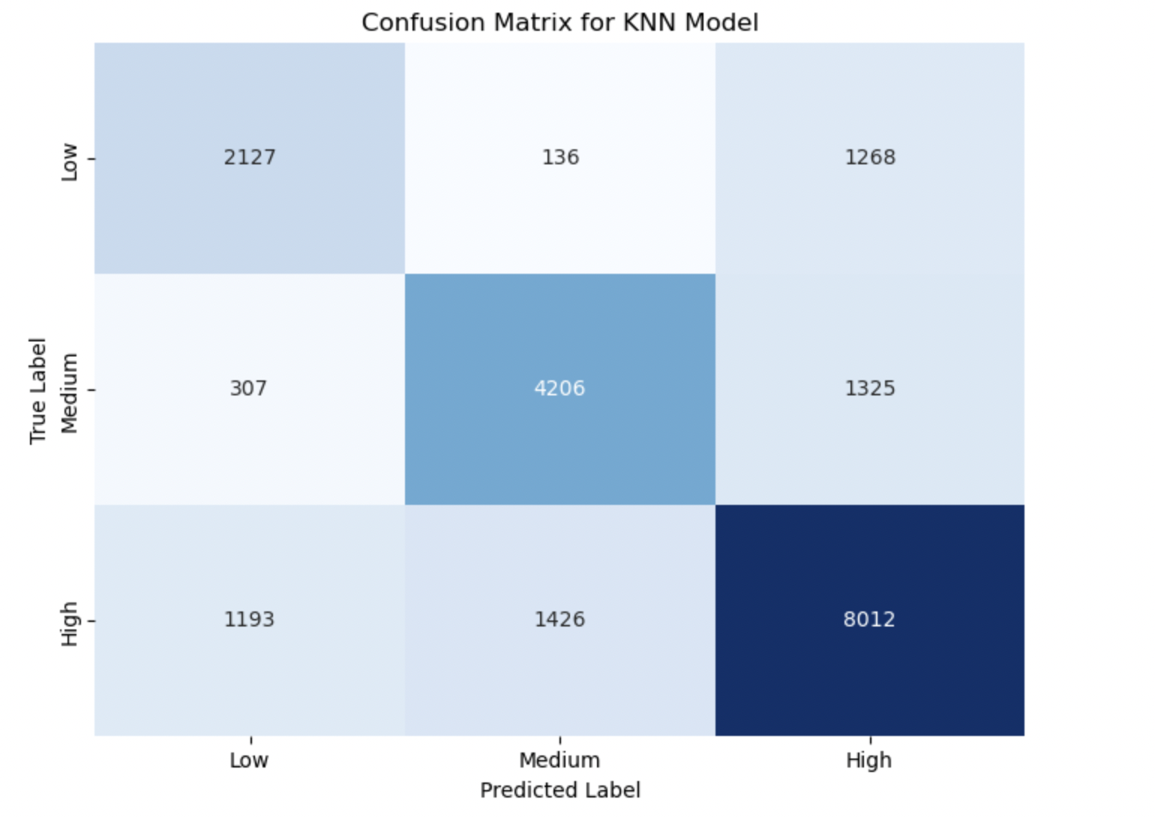
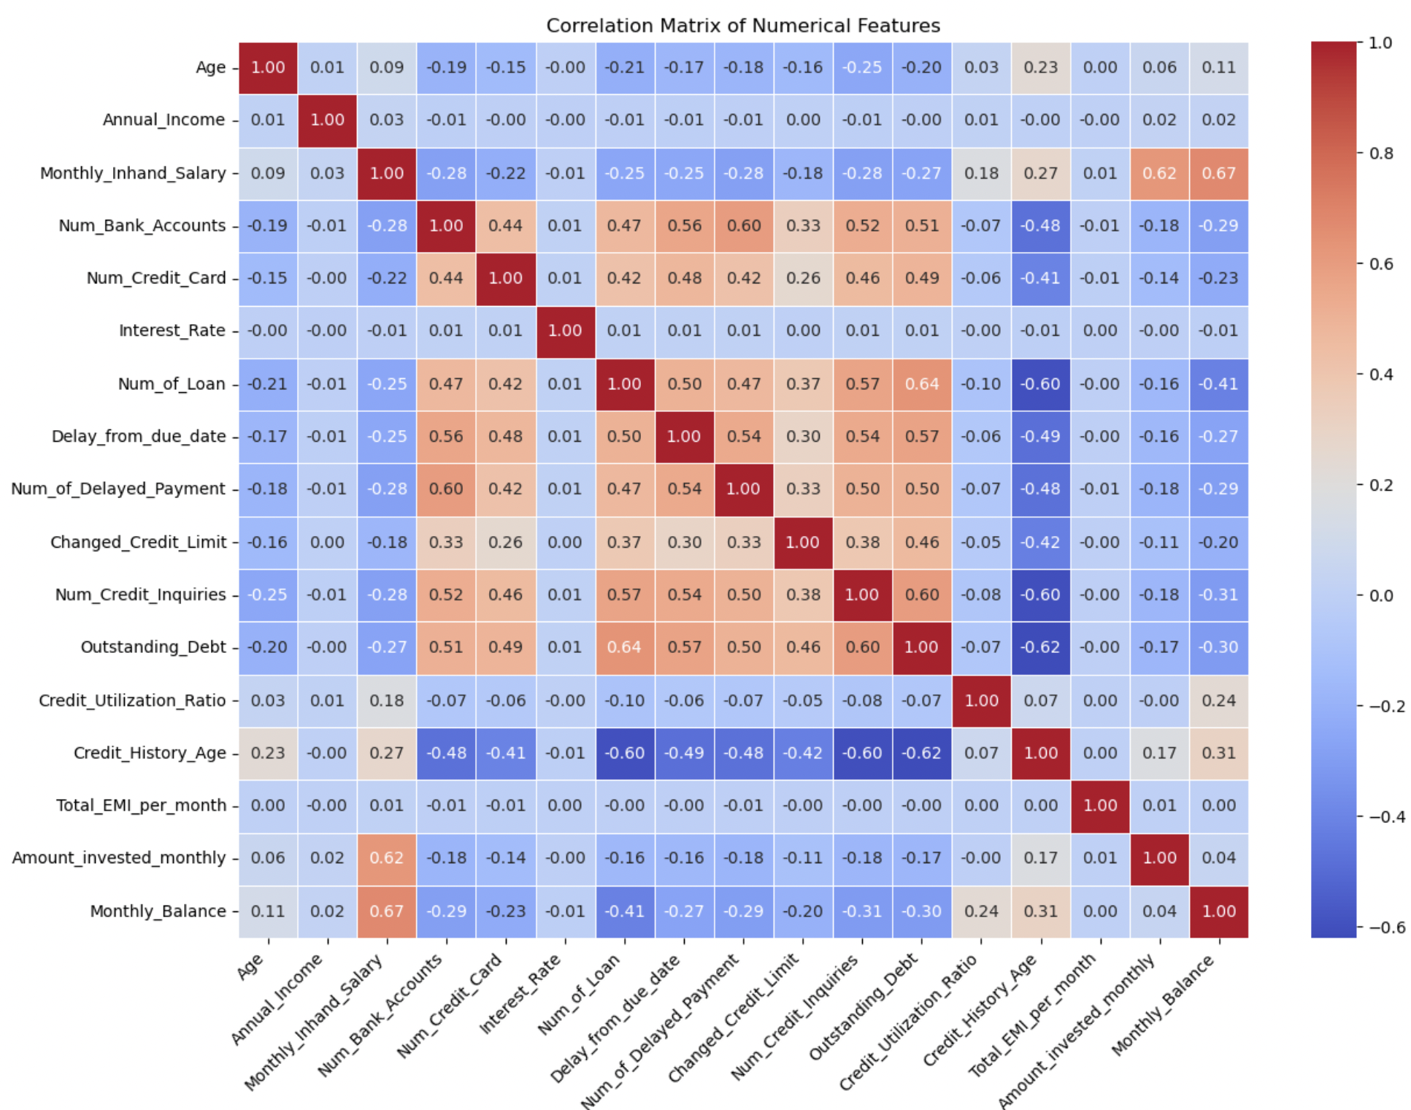
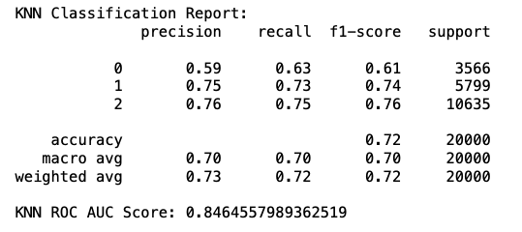
K-NN
K-Value Selection:
The model used k=5 neighbors for classification. 2) Train-Test Split:
The data was split using an 80-20 ratio.80% training data , 20% testing data
3) Distance Metric Choice:
Euclidean distance was selected as the metric for several reasons:
i) The dataset is a mixed dataset containing both types of variables.
ii) Categorical variables were encoded using LabelEncoder & continuous variables were standardized using StandardScaler to ensure all features contribute equally to distance calculations
iii) It performs well with continuous numerical features in the credit score dataset & effectively handles the dataset's multiple dimensions
iv) Particularly suitable for financial data where absolute distances between features are meaningful. This configuration achieved a 72% accuracy rate with a strong ROC-AUC score of 0.85, indicating good model performance for credit score classification.

Slide 12
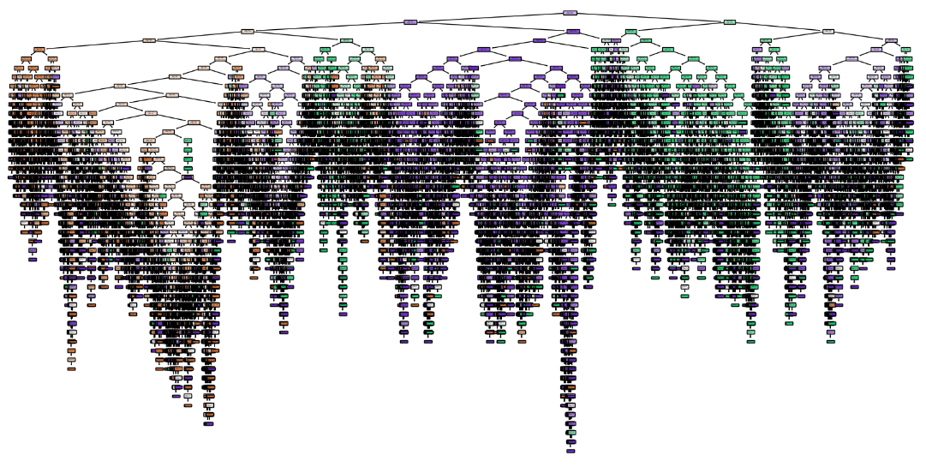
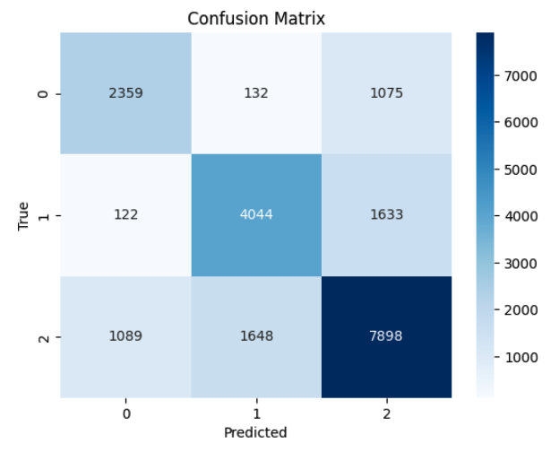
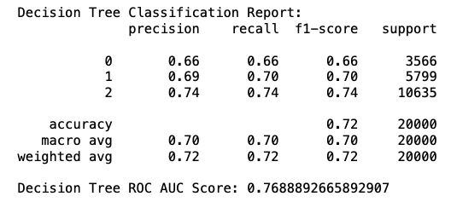
Decision Tree
Standard: 2, Good: 0, Poor: 1
The model performs best at predicting the class Standard, Poor, followed by Good

Slide 13
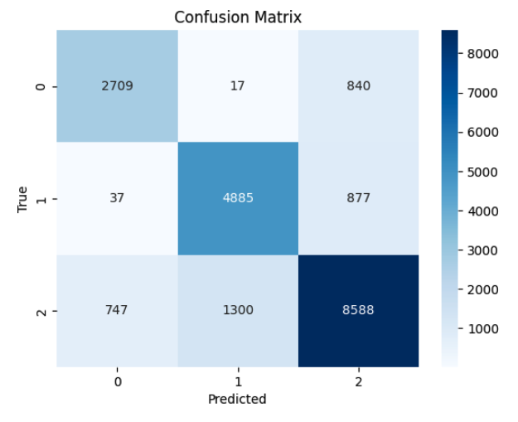
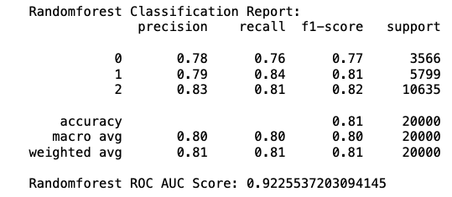
Random Forest
The model performs best at predicting 2: Standard, 1: Poor, followed by 0: Good

Slide 14
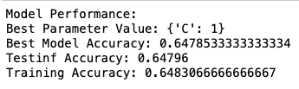
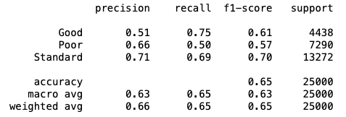
SVM
As our data is large and has about 61 possible variables, we have chosen a Linear SVM model. This model was trained using Grid Search and 5-fold Cross Validation using the 'C' parameter values as [0.0001, 0.001, 0.01, 0.1, 1, 10, 100, 1000, 10000, 100000].

Slide 15
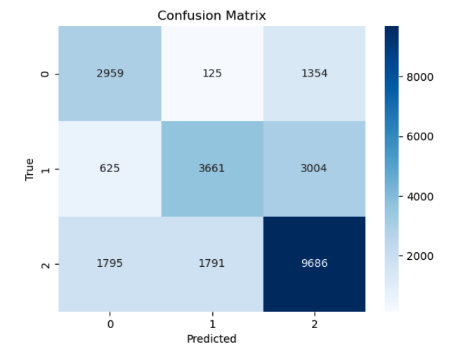
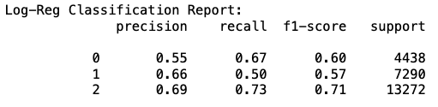
Logistic Regression
The best setting: Max_iter : 100, 'C': 100
The model performs best at predicting 2: Standard, followed by 0: Good, 1 : Poor

Slide 16
SVM & Logistic Regression & Ensemble Comparison
Model | Hyperparameters | Accuracy F1 Score
Linear SVM | Grid search for different C | 0.64796
Logisitic Regression | C: [0.01, 0.1, 1, 10, 100, 300, 500] Slover: lbfgs Max iter = 100, 200, 500, 1000, 2000 | 0.651
Logisitic Regression | Solver: saga | 0.559
Ensemble, voting Log-Reg 1000+ saga | The above settings | 0.60
Ensemble, voting SVM + Log-Reg 300 | Max iter = 500 Slover: lbfgs | 0.60

Slide 17
KNN, D-Tree, Random Forest & Ensemble Comparison
Conclusion: The Random Forest model has the best performance
Model | Hyperparameters | Accuracy F1 Score
KNN | Cross-validation = 5 Cross-validation = 8 | 0.70 0.72
Decision Tree | Cross-validation = 8 | 0.72
Random Forest | Cross-validation = 8 | 0.81
Ensemble, Voting: KNN + Decision Tree + Random Forest |  | 0.77

Slide 18
Interpret the Result
The results of our model implementations show that the Random Forest model implementation had the best performance accuracy. According to our analysis, the model gave a better performance as it is robust to overfitting, it uses the most important features for prediction and can capture non-linear relationships better than other models. This model is also versatile and better for larger datasets like ours.
KNN and Decision Tree are the next best models. KNN might not have given an optimal performance due to the high dimensional data and the fact that it is sensitive to imbalanced and scaled data. On the other hand, the Decision Tree algorithm might not show a better performance due to overfitting and the inability to handle non-linear relationships.
Lastly, the poorest performance was shown by the SVM and Logistic Regression model. Both models perform poorly due to the high dimensionality, class imbalance, and non-linear characteristics of our data.
Notes:
Most improtant features: Num_of_Delayed_Payment, Amount_invested_monthly,

Slide 19
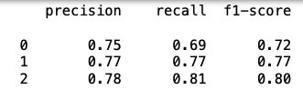
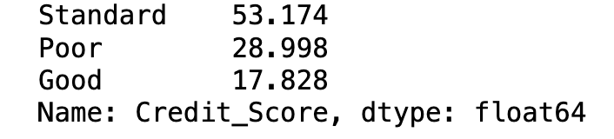
Next Step - Adjust the Imbalance Y
Deal with the imbalance credit score (y) Standard has the most data, followed by Poor and Good
The best model Random Forest is good at 2,1,0
Oversampling: increase the number of Good and Poor
Undersampling: Reduce the number of Standard
The best Log-Reg is good at 2,0, 1
2. More Ensemble Combinations
Since we separated the models into 2 groups to conduct ensemble models, maybe mixing them would have a better result
The percentage of credit score types:
Notes:
How can the next step that could increase the models perfomance?
As our data set has more standard score people, fewer poor and least good credit people,

Slide 20
Some Challenges
Missing data in financial datasets is one of the biggest challenges. This is particularly problematic in credit scoring, where certain fields (e.g., income) may be crucial for accurate predictions.
Class imbalance is another challenge because a lot of time this leads to overfitting of the model.
Credit scoring is also a significant challenge as it involves not only static features like income and employment but also temporal or sequential data such as changes in credit history over time, spending patterns, and fluctuations in financial status.
After pre-processing the data, model implementations had to be done with data having a dimensionality of 61. It is challenging to implement classification models on data of such high dimensionality because a lot of models show very poor accuracy for higher dimensional data. Some models can't even be implemented due to the same reason (e.g., Kernel SVM model).
Notes:
We tried PCA, but there were bugs and we could not fix them

Slide 21

Conclusion
Throughout the project, we successfully built and evaluated models that can accurately predict an individual's or entity's credit score based on historical financial data. We employed various techniques, including feature engineering, model selection, and evaluation metrics, to address challenges such as class imbalance, overfitting, and interpretability.
Our findings indicate that machine learning models, when properly trained and validated, outperform traditional scoring methods in terms of predictive accuracy, and have the potential to mitigate biases inherent in older credit assessment models. Moreover, the automation of this process could lead to significant cost savings for financial institutions, while offering consumers a more dynamic and personalized approach to credit evaluation.
However, several challenges prevail. For instance, the interpretability of machine learning models continues to be a critical concern, particularly when decisions about creditworthiness can have significant life-altering consequences. Additionally, ensuring data privacy and addressing ethical concerns around algorithmic decision-making are important considerations for the widespread adoption of machine learning in credit scoring.

